Slide 1
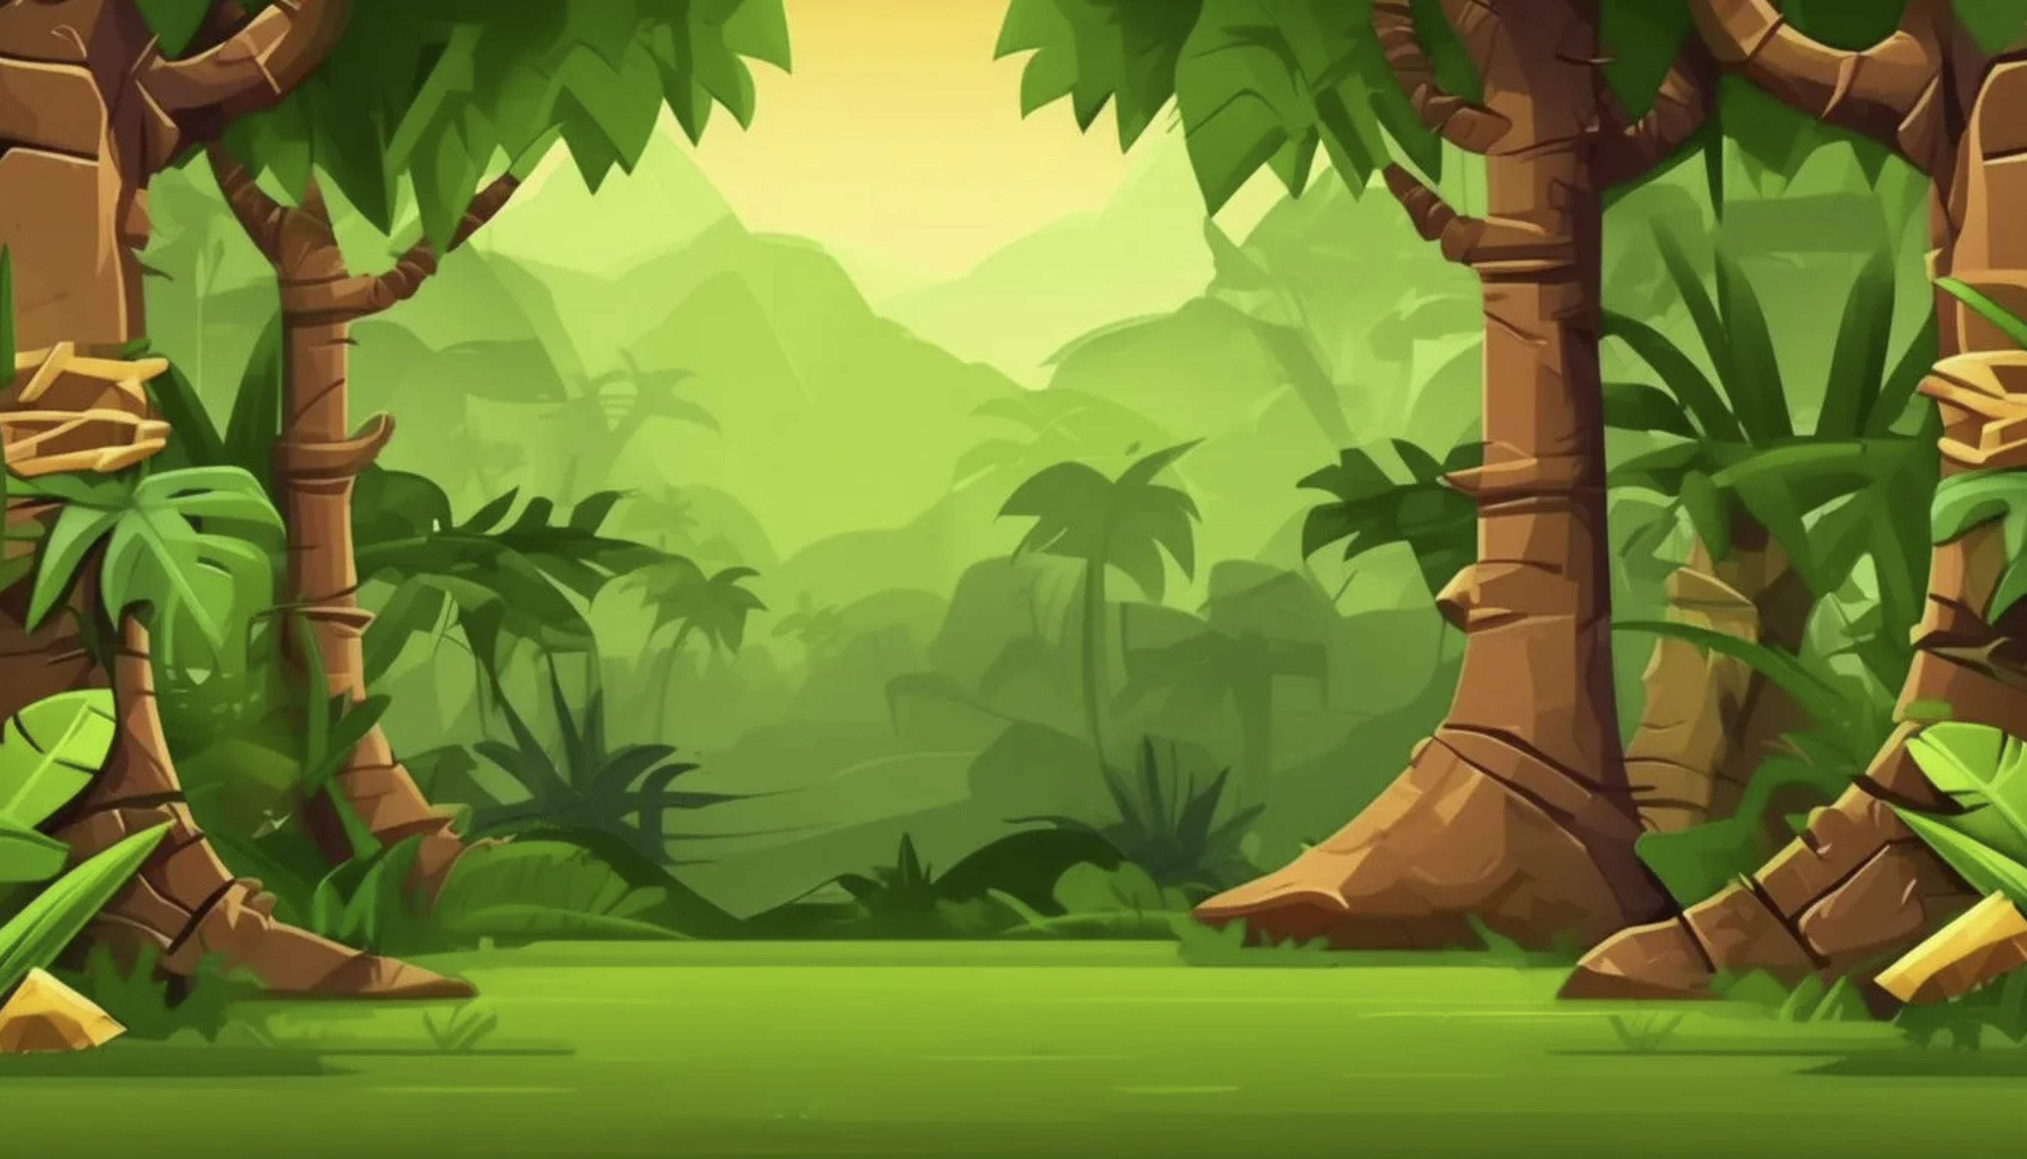
Jungle Word Mania
By Project Polygon

Slide 2
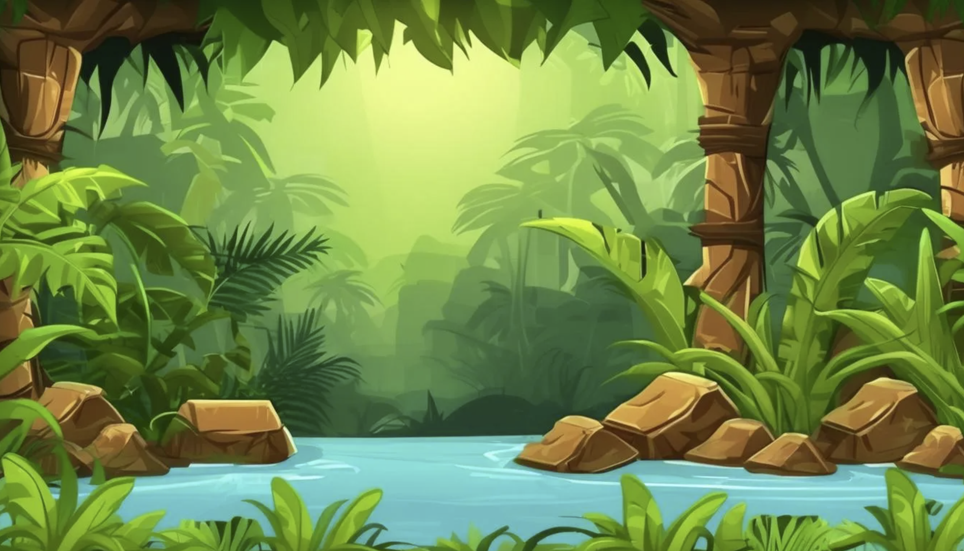
Introduction
We wanted to create a fun and engaging game for K-12 students to learn spelling and typing skills.

Slide 3
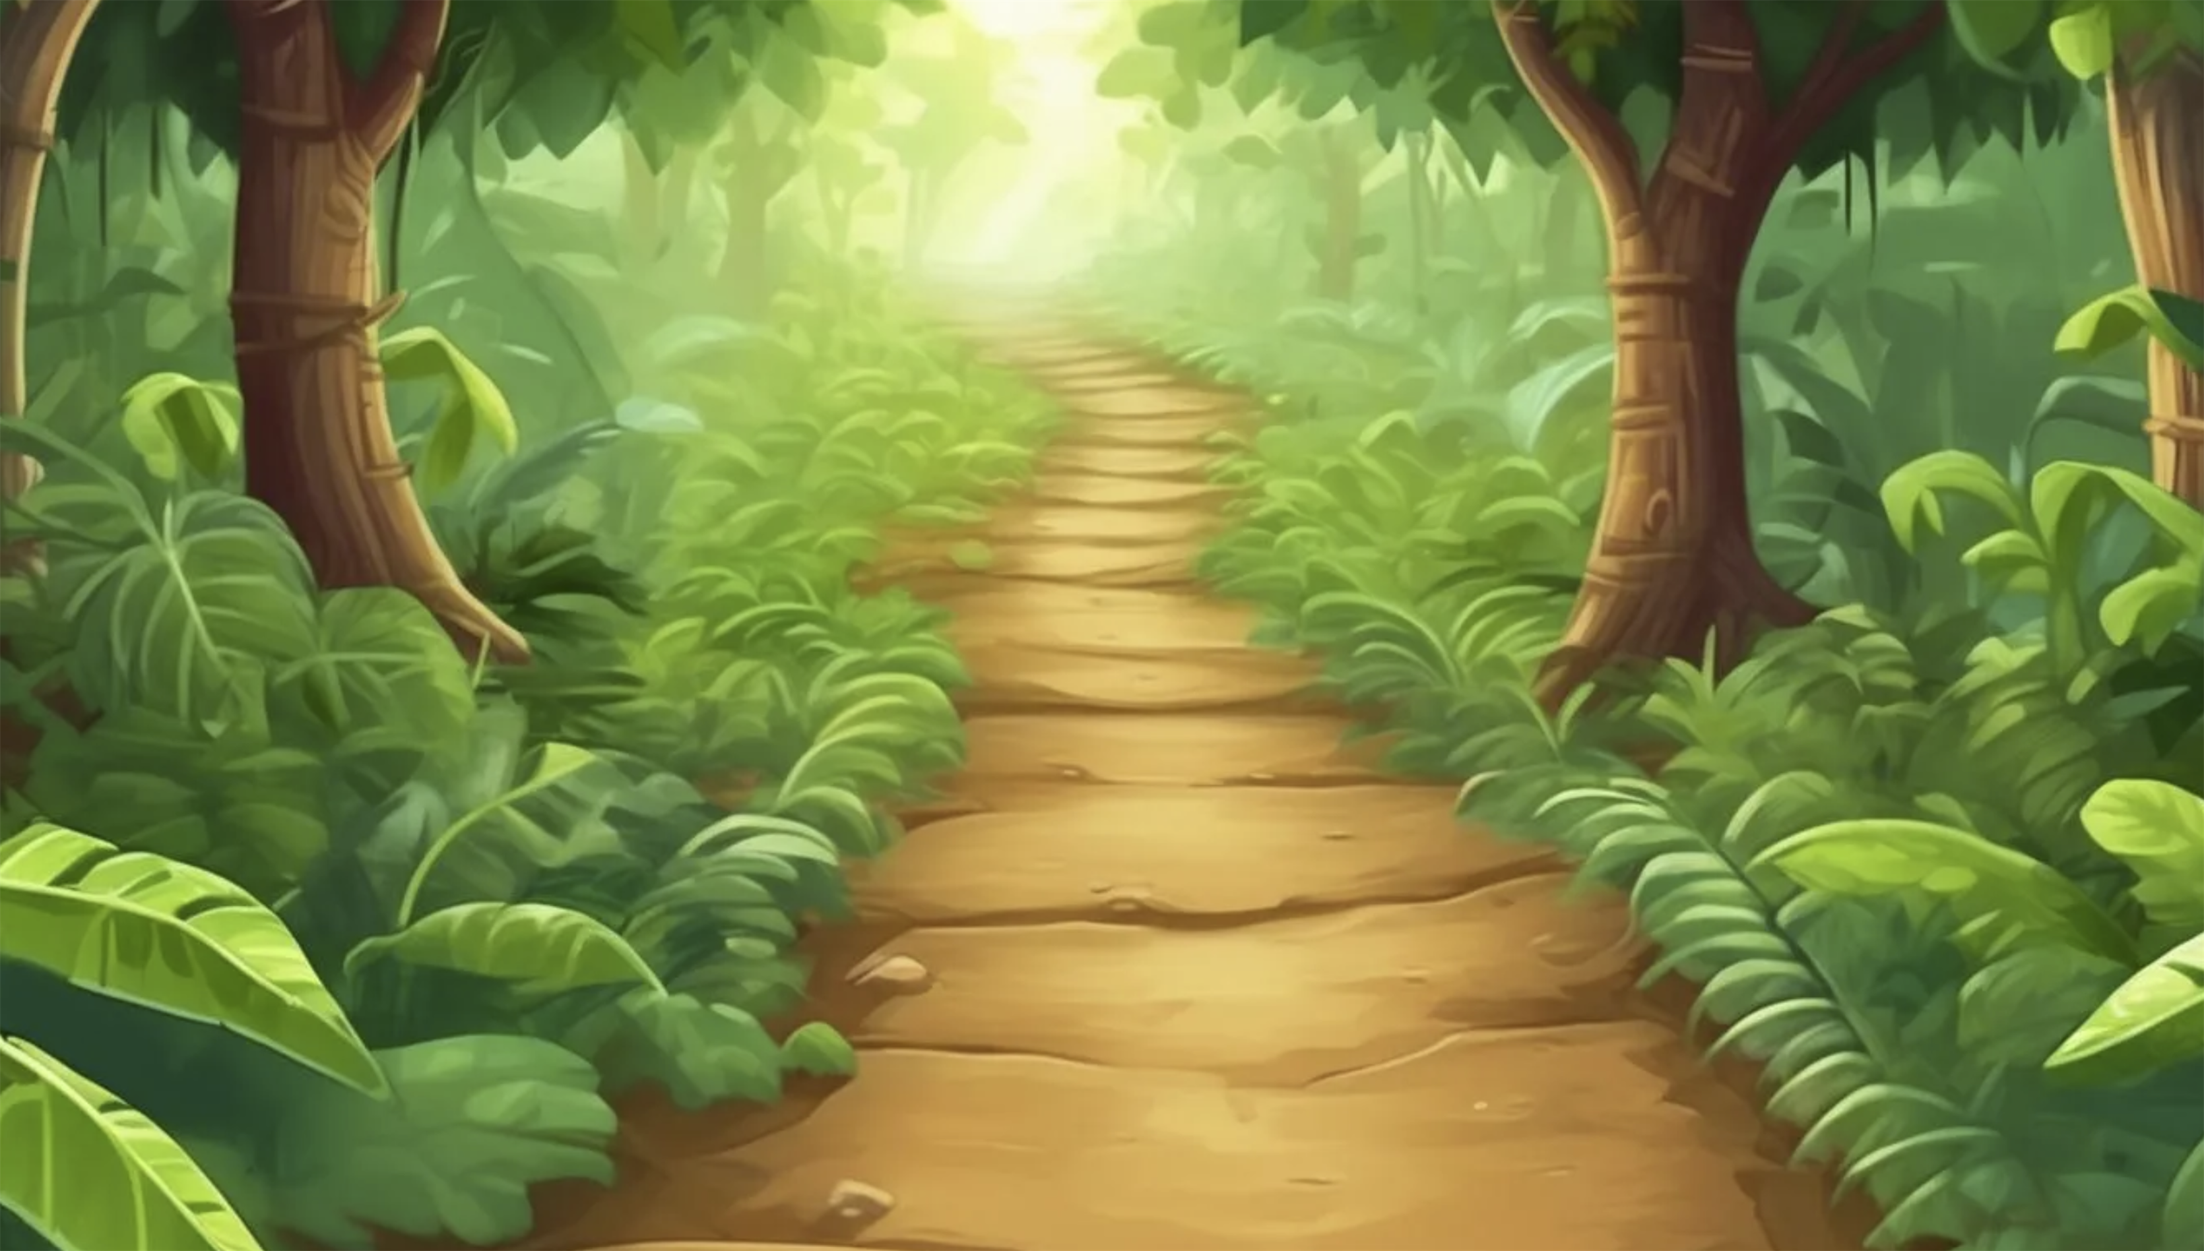
Game Specifications
The user will be given a definition
The user then tries to type in answer as quick as possible.
Scrambled letters will show up if users are stuck
When time runs out, final word will appear with correct spelling.

Slide 4
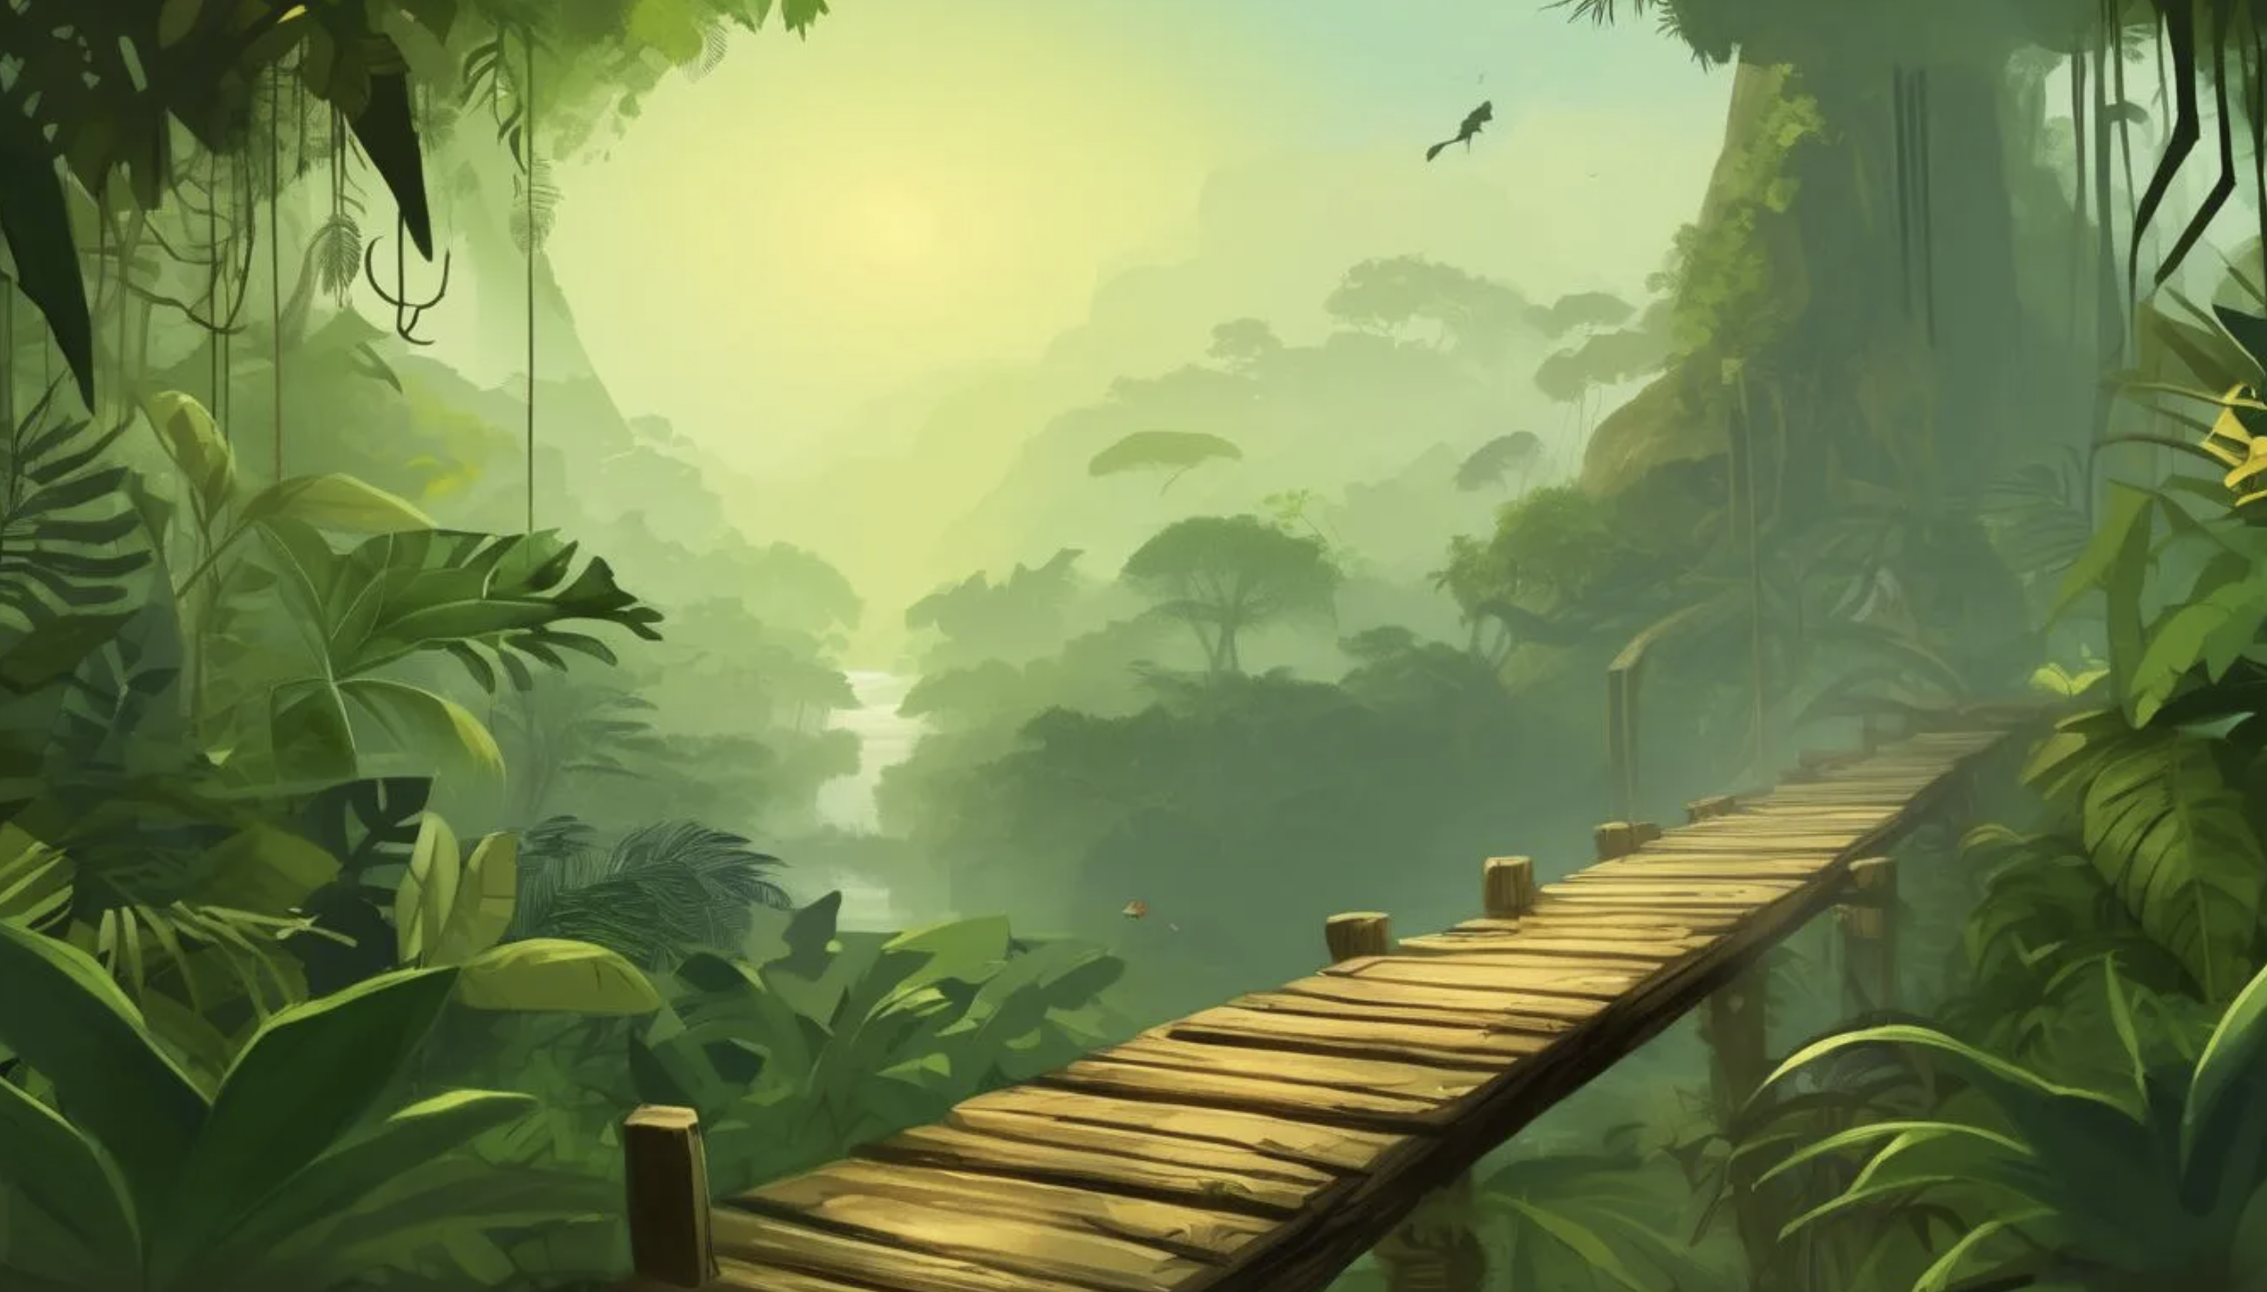
Code

Slide 5
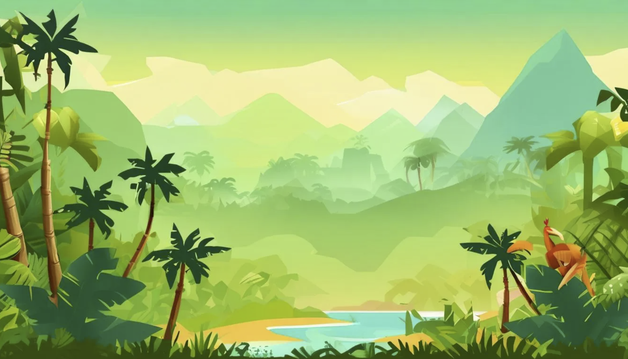
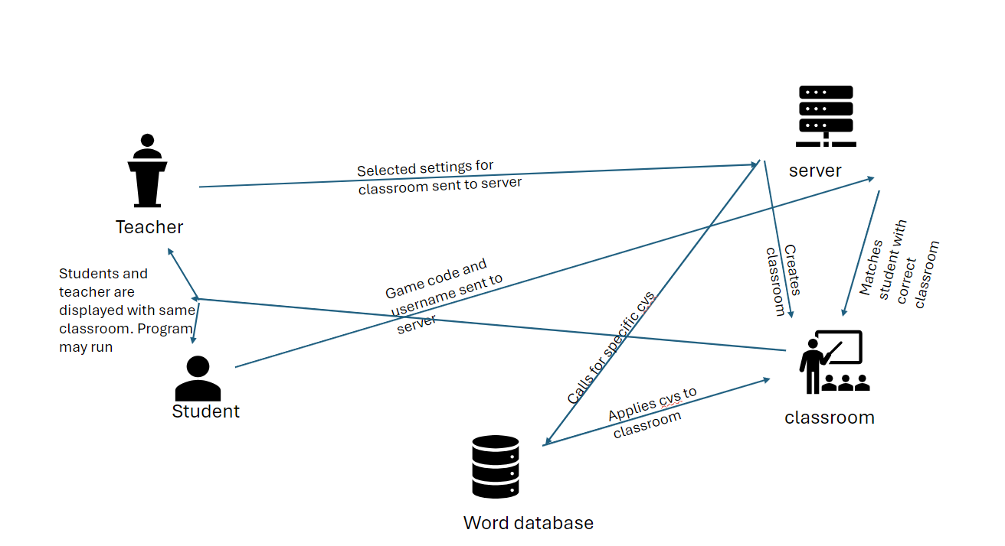
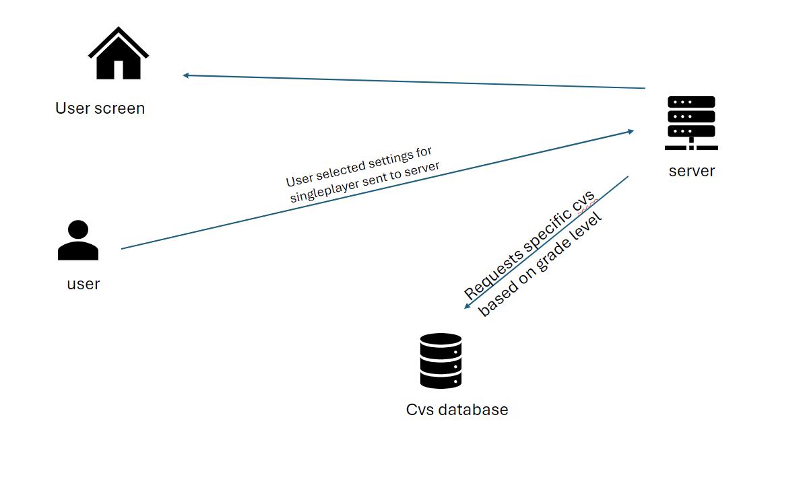
Flow Model
Multiplayer
Singleplayer

Slide 6
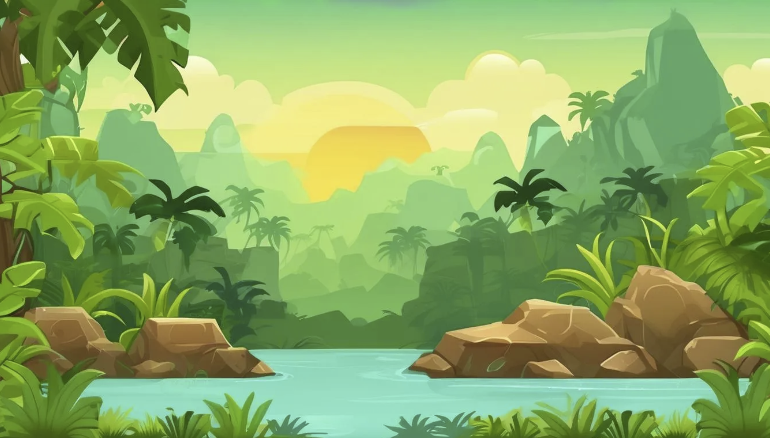
Users
Teachers can upload their own word list to personalize the game for their students
Students can competitive play and learn on their own or with the class

Slide 7
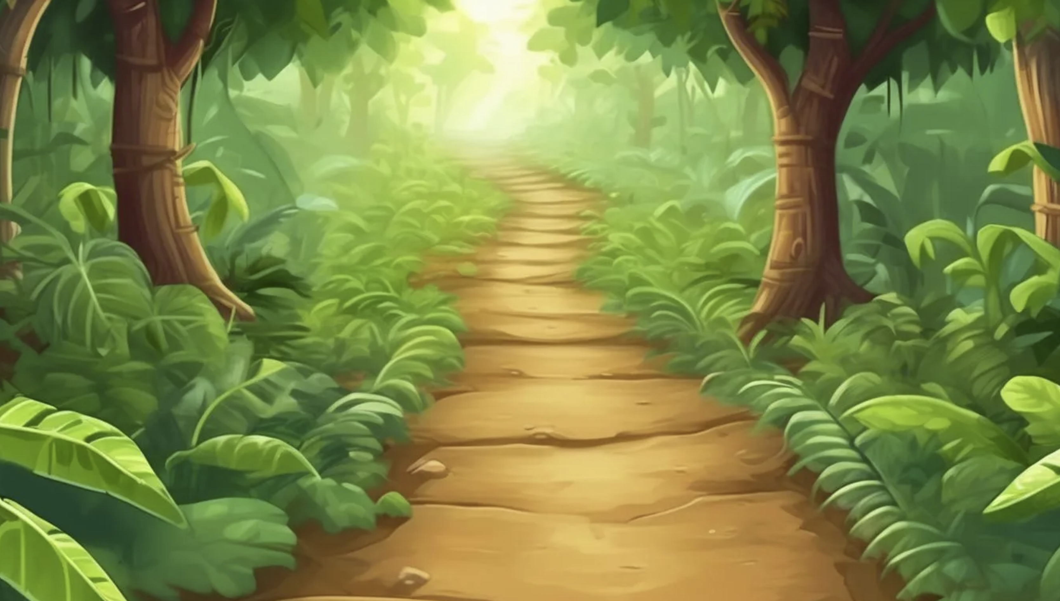
Accessibility
Adaptive Difficulty
Clear Instructions and Feedback
Engaging Game Mechanics
Age Appropriate Content
Multiplayer and Single Player Options
Educational Integration
User Testing

Slide 8
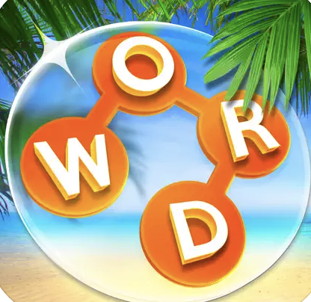
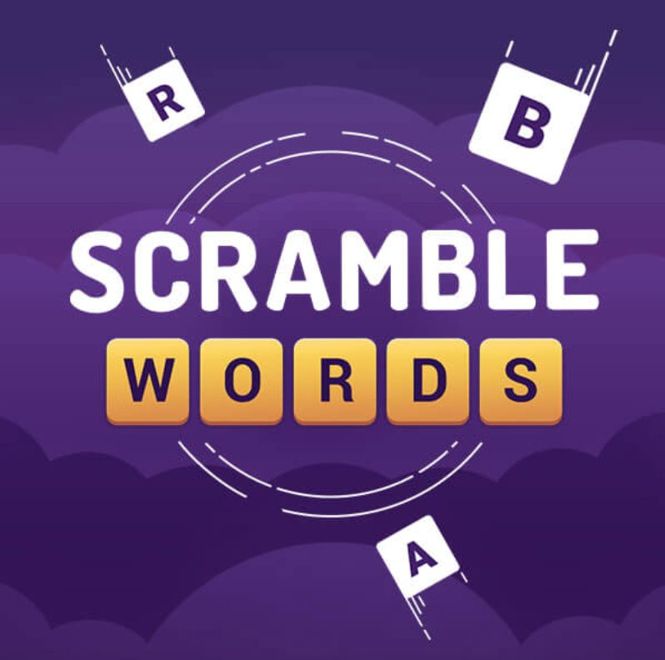
Competitors
WordScapes and Scramble Words
These are games where you have a set of letters to fill out a wider bank of words using those letters.

Slide 9
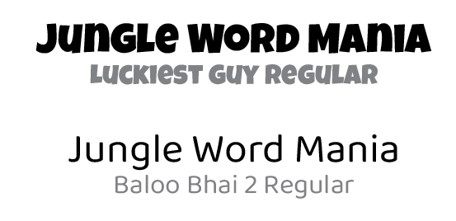
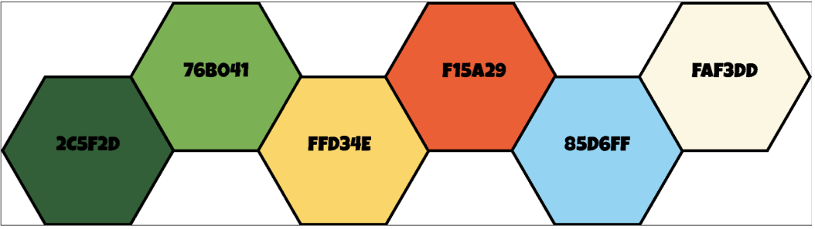
Branding

Slide 10
Demo

Slide 11
Future Development
Increase usability
Establish visual design
Add letter un-shuffling/appearing

